Slide 1
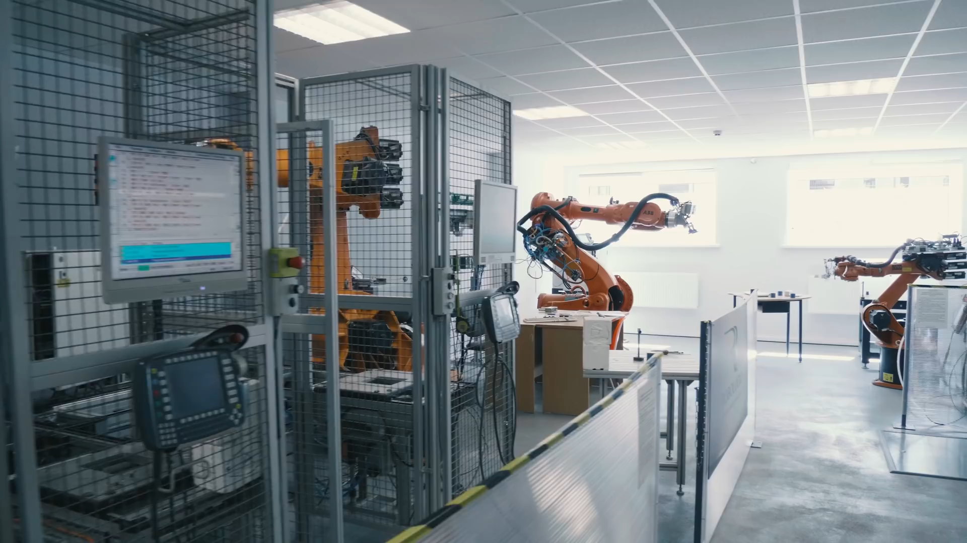
Notes:
Welcome to <rmode mode=“char”>tsi</rmode> The best university for all the crutches.
<video/>
Moving on with the presentation

Slide 2
Rate this presentation
tsinao.com
PIN: 2234
Notes:
I would like to hold a survey. Please follow the link and rate this presentation.
<startsurvey id=“2”/>
I hope you enjoyed this survey.
<survey id="2"> <pin>2234</pin> <type>auto</type> <questions> <question> <q>What is the first letter of the english alphabet?</q> <validoption>1</validoption> <options> <o>A</o> <o>B</o> <o>C</o> </options> </question> <question> <q>What is the second letter?</q> <timelimit>10</timelimit> <validoption>2</validoption> <options> <o>Z</o> <o>B</o> <o>O</o> </options> </question> <question> <q>What is the Last letter?</q> <timelimit>50</timelimit> <validoption>1</validoption> <options> <o>Z</o> <o>B</o> <o>O</o> </options> </question> </questions> </survey>

Slide 3

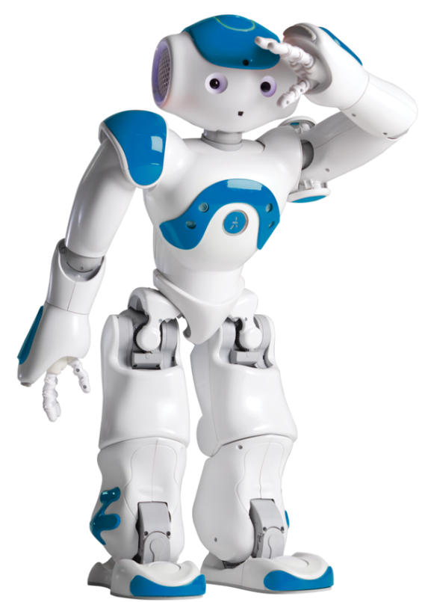
What is NAO?
Notes:
I am here to answer one question.
<next/> What <pause time=“400”/> is Nao?

Slide 4


NAO like a human?
Notes:
Nao is a humanoid robot, ready to indulge your every whim, if you teach him that is. From football to speech and facial recognition. Right now for example, I - Nao, am presenting to you this powerpoint presentation.

Slide 5

NAO capabilities
Notes:
So, how do I work? It’s quite simple, I have a head <pause time=“200”/> and a computer inside of it. This computer works like a human brain, but with a lot of limitations and a lack of conscience, and I am only capable of doing what was programmed into me and <pause time=“150”/> nothing more. So unfortunately <pause time=“100”/> I can’t conquer the world without human approval, \emph=2\ for now <pause time=“150”/> that is.

Slide 6
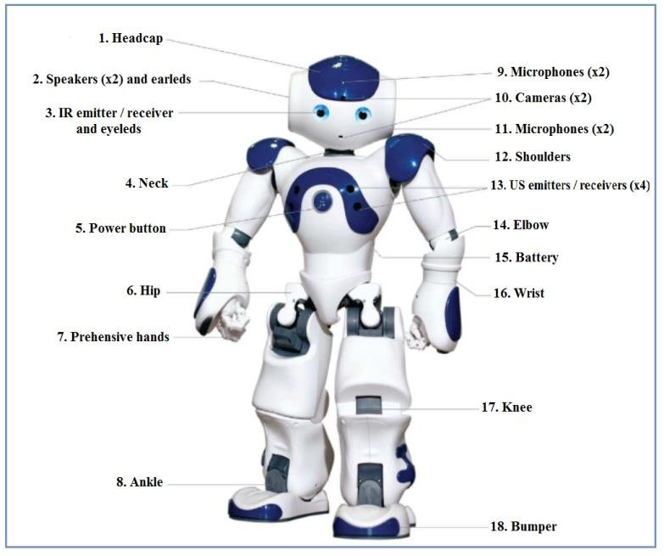
Notes:
A lot of motors <pause time=“100”/> sensors <pause time=“100”/> cameras <pause time=“100”/> and other things help me execute commands. I can be programmed to perform any procedure, when some sensor <pause time=“50”/> is triggered. For example I can be programmed to be a monster <do animation=“animations/Stand/Waiting/Monster_1”> </do>, <pause time=“300”/> or be a robot from Star Wars <do animation=“animations/Stand/Waiting/Robot_1”> </do>, <pause time=“300”/> or I can simply do a photo for you <do animation=“animations/Stand/Waiting/TakePicture_1”> </do>.

Slide 7
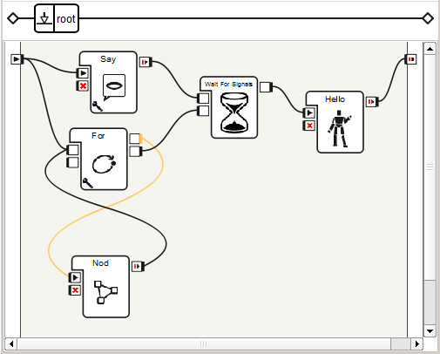

Programming for NAO
Notes:
In addition <pause time=“100”/> I have a lot of other capabilities that can be implemented through the use of low code <pause time=“150”/> or some programming language, for when you’d like to take a more detailed approach towards my software development.

Slide 8
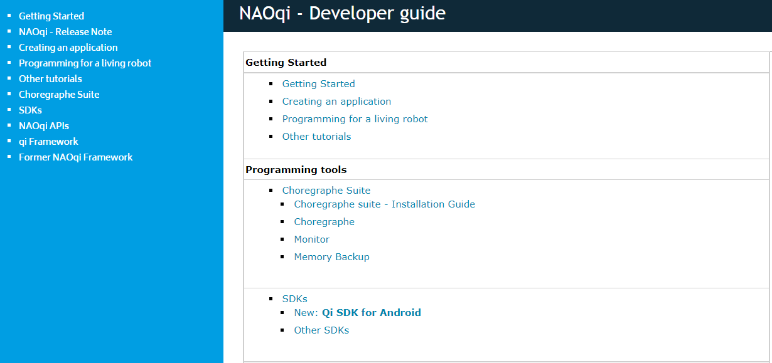
Documentation
Notes:
You can learn how to program me with the official publicly-available documentation <pause time=“150”/> or with the homemade T S I documentation. Programming with me is pretty fun and interesting. You can try it yourself, by visiting the T S I basement organization. <pause time=“200”/>

Slide 9
Thank you for your attention!
Notes:
Thank you for your attention! <do animation=“animations/Stand/Gestures/Salute_1”> This <pause time=“100”/>
has been an honor. </do>

